Slide 1

Fourier and
Fourier Transform
Why should we learn Fourier Transform?

Slide 2
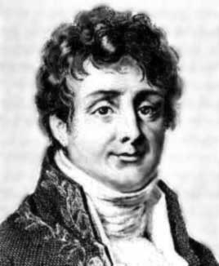
Joseph Fourier
Joseph’s father was a tailor in Auxerre
Joseph was the ninth of twelve children
His mother died when he was nine and
his father died the following year
Fourier demonstrated talent on math
at the age of 14.
In 1787 Fourier decided to train for
the priesthood - a religious life or a
mathematical life?
In 1793, Fourier joined the local
Revolutionary Committee
Born: 21 March 1768 in Auxerre, Bourgogne, France
Died: 16 May 1830 in Paris, France

Slide 3
Fourier’s “Controversy” Work
Fourier did his important mathematical work on the theory of heat (highly regarded memoir On the Propagation of Heat in Solid Bodies ) from 1804 to 1807
This memoir received objection from Fourier’s mentors (Laplace and Lagrange) and not able to be published until 1815
Napoleon awarded him a pension of 6000 francs, payable from 1 July, 1815.
However Napoleon was defeated on 1 July and Fourier did not receive any money

Slide 4
Expansion of a Function
Example (Taylor Series)
constant
first-order
term
second-order
term
…

Slide 5

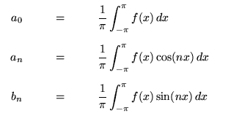
Fourier Series
Fourier series make use of the orthogonality relationships of
the sine and cosine functions

Slide 6
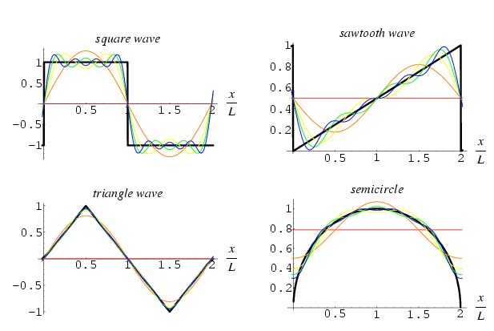
Examples

Slide 7
Fourier Transform
The Fourier transform is a generalization of the complex Fourier series in the limit
Fourier analysis = frequency domain analysis
  Low frequency: sin(nx),cos(nx) with a small n
  High frequency: sin(nx),cos(nx) with a large n
Note that sine and cosine waves are infinitely long – this is a shortcoming of Fourier analysis, which explains why a more advanced tool, wavelet analysis, is more appropriate for certain signals

Slide 8
Applications of Fourier Transform
Physics
  Solve linear PDEs (heat conduction, Laplace, wave propagation)
Antenna design
  Seismic arrays, side scan sonar, GPS, SAR
Signal processing
  1D: speech analysis, enhancement …
  2D: image restoration, enhancement …

Slide 9
Not Just for EE
Just like Calculus invented by Newton, Fourier analysis is another mathematical tool
BIOM: fake iris detection
CS: anti-aliasing in computer graphics
CpE: hardware and software systems

Slide 10
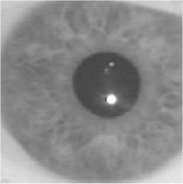
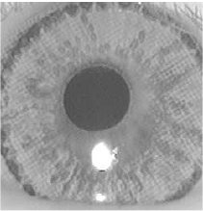
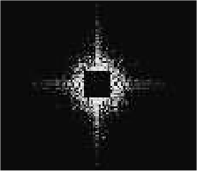
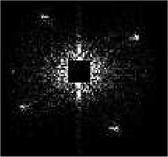
FT in Biometrics
natural
fake

Slide 11
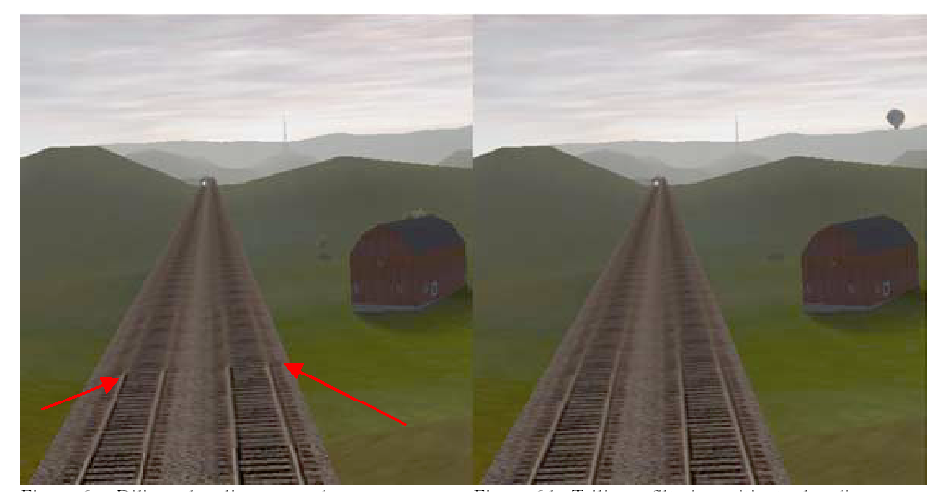
FT in CS
Anti-aliasing in 3D graphic display

Slide 12
FT in CpE
Computer Engineering: The creative application of engineering principles and methods to the design and development of hardware and software systems
If the goal is to build faster computer alone (e.g., Intel), you might not need FT; but as long as applications are involved, there is a place for FT (e.g., Texas Instrument)

Slide 13

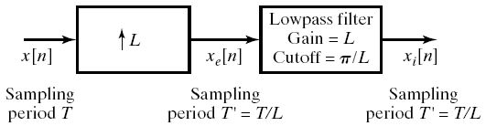
Frequency-Domain Analysis of Interpolation
Step-I: Upsampling
Step-II: Low-pass filtering
Different interpolation schemes correspond to different low-pass filters

Slide 14
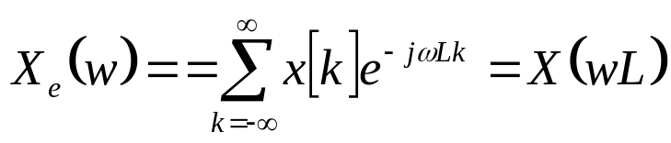
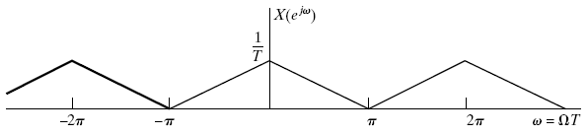
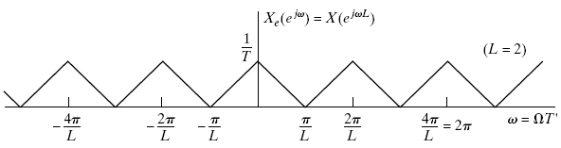
Frequency Domain Representation of Upsampling

Slide 15
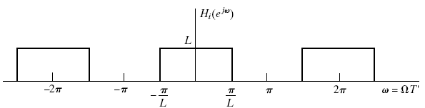
Frequency Domain Representation of Interpolation

